Slide 1
Introduction to Classes and Objects
Introduction to Classes and Objects

Slide 2
C++
A calendar program might want to store information
about dates, but C++ does not have a Date type.
A student registration system needs to store info
about students, but C++ has no Student type.
A bank app might want to store information about
users' accounts, but C++ has no BankAccount type.
However, C++ does provide a feature for us to add
new data types to the language: classes.
  Writing a class defines a new data type.
Introduction to Classes and Objects

Slide 3
Object Oriented Programming
The idea of OO programming is to model the features (aka properties or attributes) and behavior of real-world objects in the problem domain by software objects (aka instances).
The class construct provides a template (or blueprint) for the creation of objects.
Classes specify what attributes and behavior an object may have.
May create many objects from a given class
- Each object will have its own attribute, but will have identical behaviour.
Introduction to Classes and Objects

Slide 4
C++ Program Structure
Typical C++ Programs consist of:–
  A function main
  One or more classes
    Each containing data members and member functions.
Introduction to Classes and Objects

Slide 5
Defining a Class
With a Member Function
Class definition
  Tells the compiler what member functions and data members belong to the class.
  Keyword class followed by the class’s name.
  Class body is enclosed in braces ({})
    Specifies data members and member functions
    Access-specifier public:
      Indicates that a member function or data member is accessible to other functions and member functions of other classes.
Introduction to Classes and Objects

Slide 6
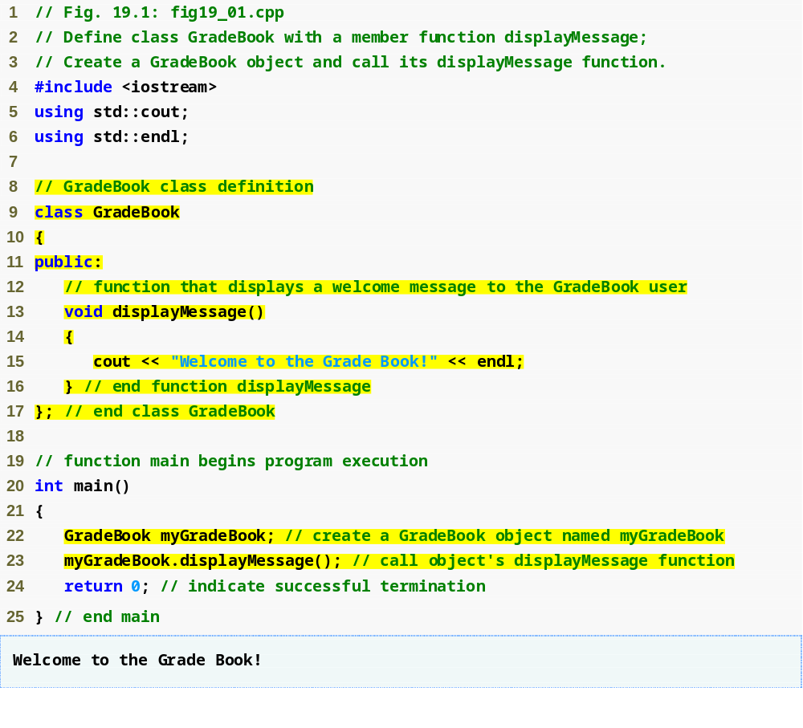
C++ Gradebook Example
“using”:– add the name to the current scope
CS-2303, C-Term 2010
Introduction to Classes and Objects

Slide 7
C++ Gradebook Example
Beginning of class definition for class GradeBook
Beginning of class body
Access specifier public; makes members available to the public
Member function displayMessage returns nothing
End of class body
Use dot operator to call GradeBook’s member function
CS-2303, C-Term 2010
Introduction to Classes and Objects

Slide 8
C++ Gradebook Example
Declaring an object of this class
as an automatic variable of main
I.e., allocated on The Stack
CS-2303, C-Term 2010
Introduction to Classes and Objects

Slide 9
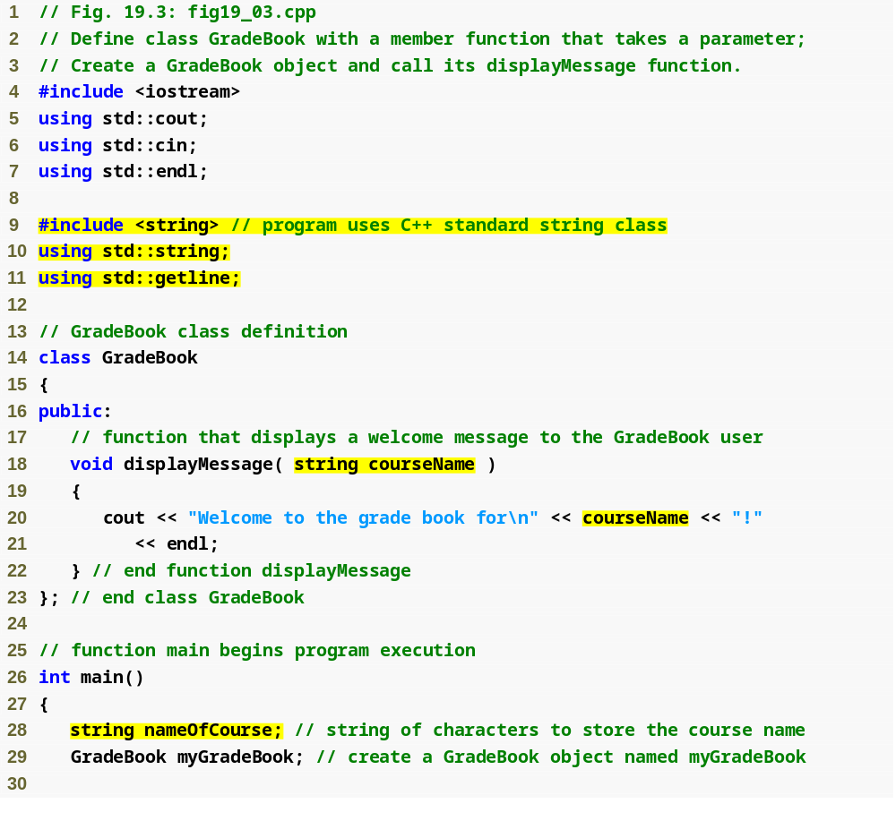
Member Functions with Parameters
Include string class definition
Member function parameter
Use the function parameter as a variable
Introduction to Classes and Objects

Slide 10
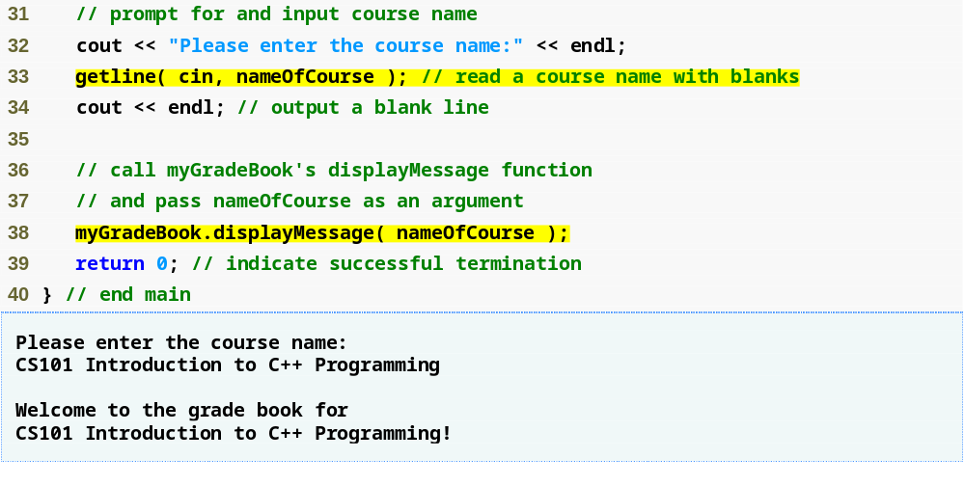
Member Functions with Parameters (cont.)
Passing an argument to the member function
Introduction to Classes and Objects

Slide 11
Useful Tidbits
A string
  Represents a string of characters.
  An object of C++ Standard Library class std::string
    Defined in header file <string>.
  Not a character array as in C.
Library function getline
  Used to retrieve input until newline is encountered
  Example
    getline( cin, nameOfCourse );
      Inputs a line from standard input into string object nameOfCourse.
    Defined in header file <iostream>.
Introduction to Classes and Objects

Slide 12
Data Members of a Class
Declared in the body of the class
May be public or private
Exist throughout the life of the object.
Stored in class object.
Each object has its own copy.
    May be objects of any type
Introduction to Classes and Objects

Slide 13
Access-specifier private
Makes any member accessible only to member functions of the class.
    May be applied to data members and member functions
Default access for class members
    Encourages “information hiding”
Introduction to Classes and Objects

Slide 14
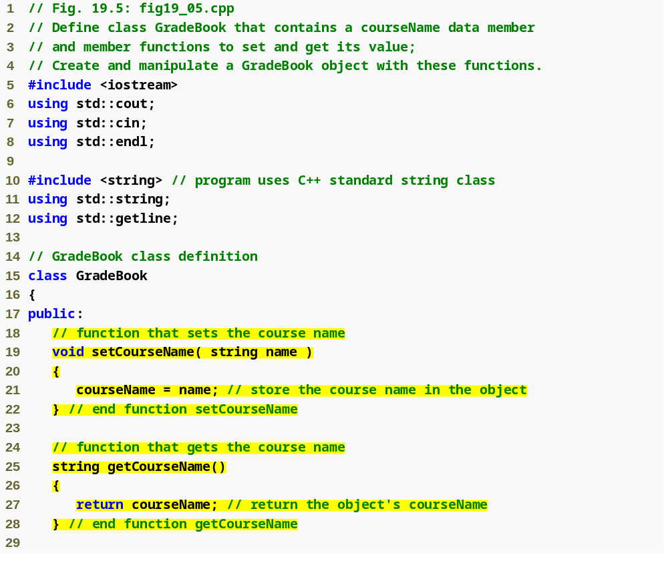
Public and Private Members
set function modifies private data
get function accesses private data
Introduction to Classes and Objects

Slide 15
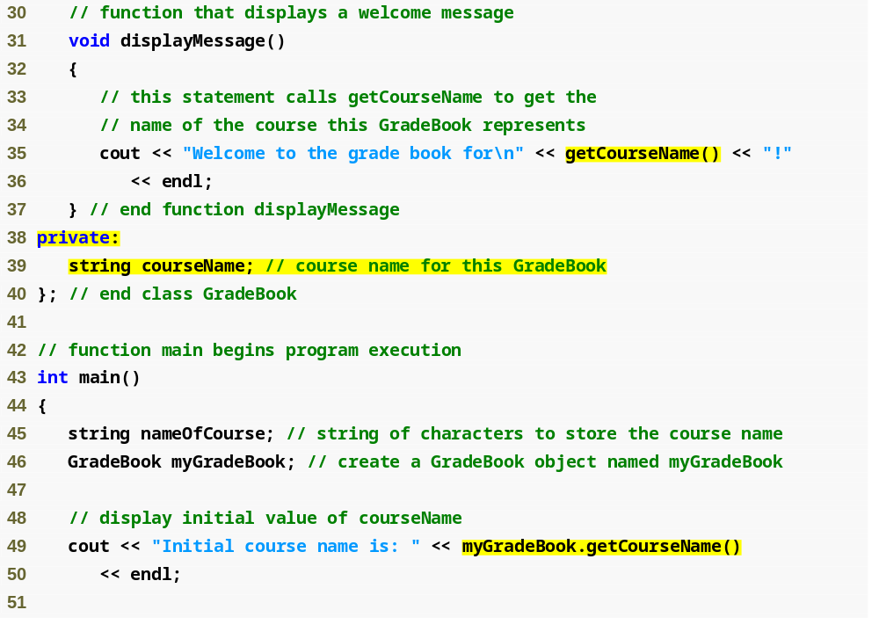
Public and Private Members (continued)
Use set and get functions, even within the class
private members accessible only to member functions of the class
default constructor
Accessing private data outside class definition
Introduction to Classes and Objects

Slide 16
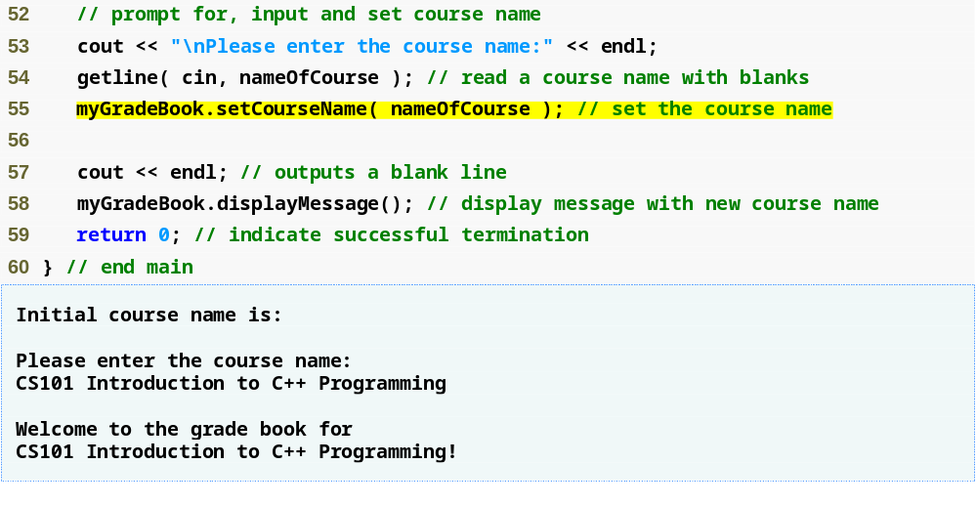
Public and Private Members (continued)
Modifying private data outside class definition
default setting from constructor
is an empty string!!
Introduction to Classes and Objects

Slide 17
Software Engineering Observation
As a rule of thumb, data members should be declared private
Member functions should be declared public.
  Except member functions that are accessed only by other member functions of the class.
Often useful to have get and set functions
  To access private members in controlled ways
Introduction to Classes and Objects

Slide 18
Constructors and Destructors
Constructor:– a function used to initialize the data of an object of a class
  Same name as class itself
  Cannot return anything, not even void
  A class may define more than one constructor
    With different parameter lists
    Default constructor has no parameters
Called automatically
  When class object is declared as automatic variable
  By new operator
Compiler provides one
if you do not!
Compiler’s default simply calls constructors of data members of the class.
Introduction to Classes and Objects

Slide 19
Constructors and Destructors (continued)
Destructor:– a function used to clean up an object of a class prior to deleting that object
  Class name preceeded by '~'
  No parameters, no result
Called automatically
  When function exits scope of automatic class object
  By delete operator
Compiler provides one
if you do not!
Compiler’s default simply calls destructors of data members of the class.
Introduction to Classes and Objects

Slide 20
Constructors and Destructors (continued)
Constructors – Similar to Java
Destructors – No counterpart in Java
Purpose of Destructors
    Free dynamic storage pointed to only by members of object
    Reduce reference count when object disappears
    Safely close things – e.g., files
    …
Introduction to Classes and Objects

Slide 21
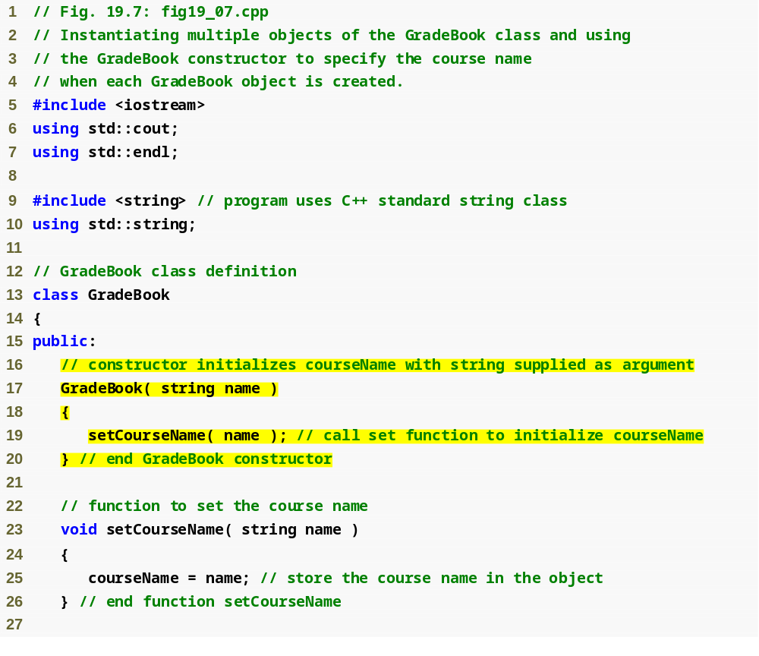
Constructor Example
Constructor has same name as class and no return type
Initialize data member
Introduction to Classes and Objects

Slide 22
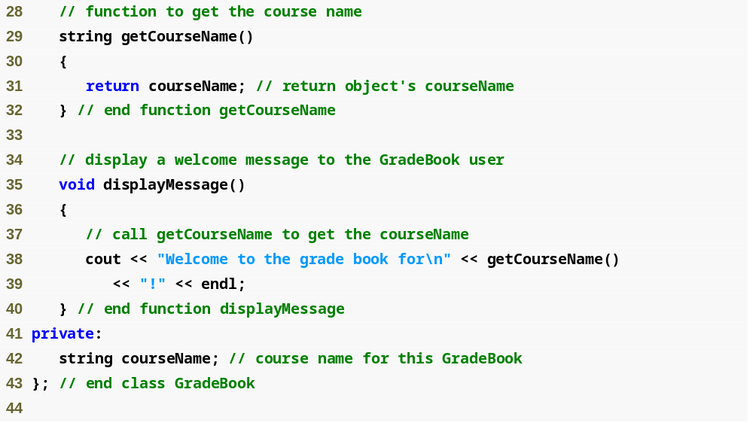
Constructor Example
Destructor need so this class object
can free dynamically allocated memory
Introduction to Classes and Objects

Slide 23
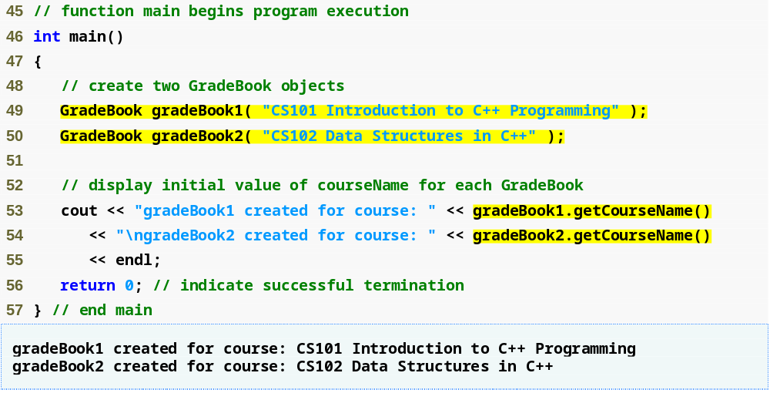
Constructor Example
Creating objects implicitly calls the constructor
Introduction to Classes and Objects

Slide 24
Class in a Separate Header File for Reusability
.cpp files for source-code implemenations
  Class implementations
  Main programs
  Test programs
  …
Header files
  Separate files in which class definitions are placed.
  Allow compiler to recognize the classes when used elsewhere.
  Generally have .h filename extensions
Driver file
  A program used to test software (such as classes).
  Contains a main function so it can be executed.
Introduction to Classes and Objects

Slide 25
Interfaces versus Implementation
Interface
  Describes what services a class’s clients can use and how to request those services.
    without revealing how the class carries out the services.
    a class definition listing only public member function prototypes.
  A class’s interface consists of the class’s public member functions (services).
Defined in class header file (.h)
Introduction to Classes and Objects

Slide 26
Interfaces versus Implementation
Implementation of member functions
  In a separate source-code file for a class
    Use binary scope resolution operator (::) to tie each member function to the class definition.
  Implementation details are hidden.
    Client code does not need to know the implementation.
Introduction to Classes and Objects

Slide 27
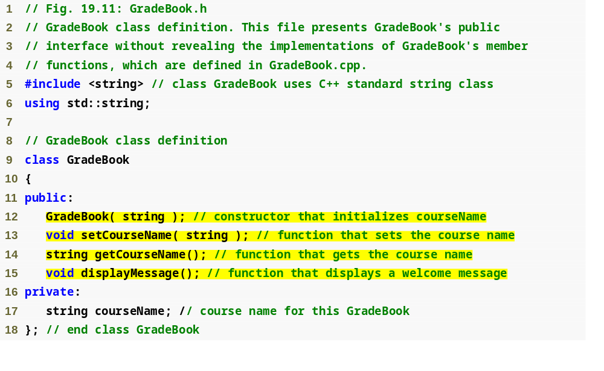
Interfaces versus Implementation (Example)
Interface contains data members and member function prototypes
Introduction to Classes and Objects

Slide 28
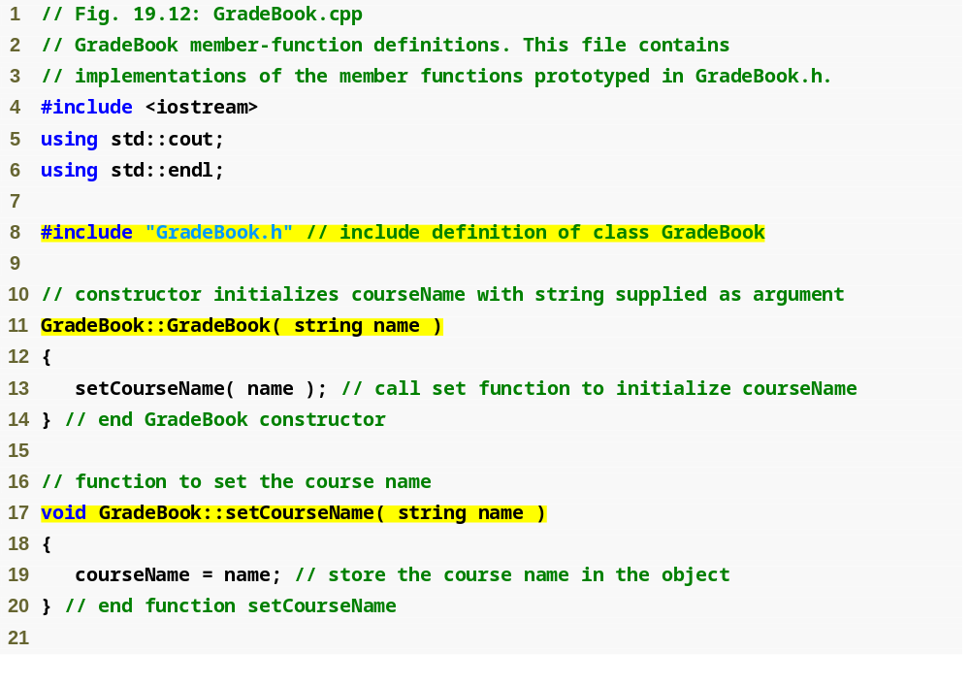
Interfaces versus Implementation (continued)
GradeBook implementation is placed in a separate source-code file
Include the header file to access the class name GradeBook
Binary scope resolution operator ties a function to its class
Introduction to Classes and Objects

Slide 29
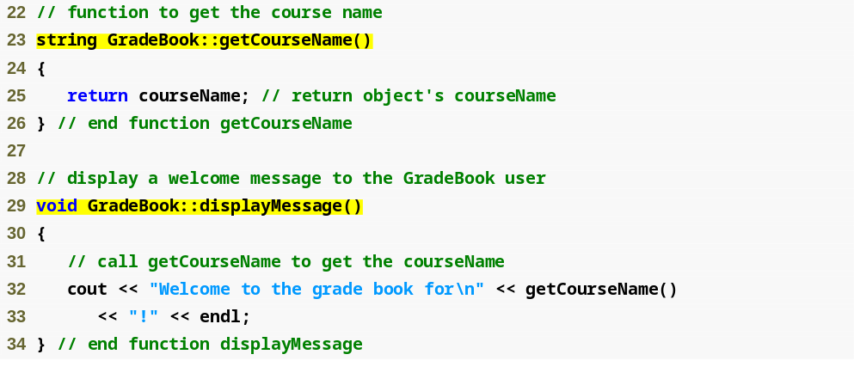
Interfaces versus Implementation (continued)
Introduction to Classes and Objects

Slide 30
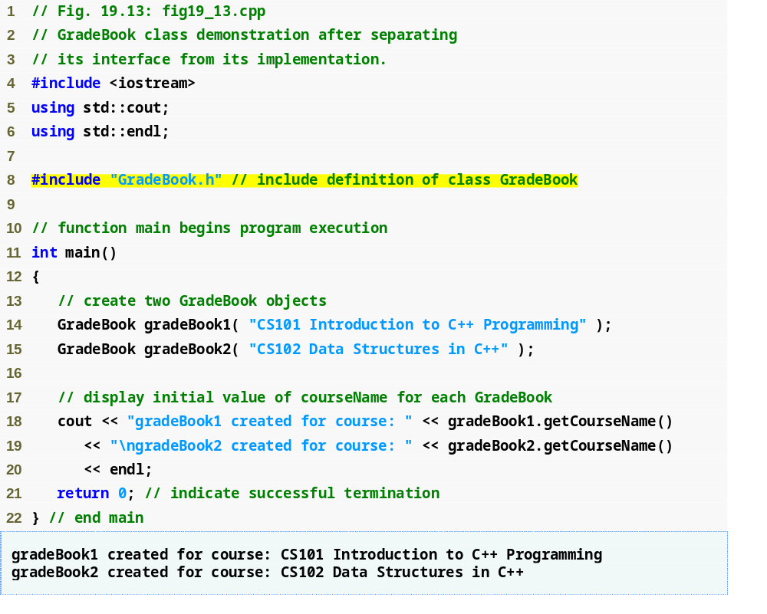
Client of the Interface
Introduction to Classes and Objects

Slide 31
Summary
Introduced class definitions and objects
  Public versus private access into class.
Syntax for member functions
Syntax data members
  Get and Set functions
  Constructors & Destructors
Placing classes in separate files
Separating interface from implementation
Introduction to Classes and Objects

Slide 32
Questions?
Reading:–
Deitel & Deitel, Chapter 19
Introduction to Classes and Objects

